Slide 1
UNIT I

Slide 2
SITE REQUIREMENTS
It should serve the intended purposes.
It should be uniform in geometrical shape since with irregular shape land is wasted.
It should have enough space for the future requirements.
To reduce constructional cost, hard and firm strata should be available at a shallow depth.
It should be safe and in well secured locality.
Site near nalla or river should be avoided.
It should be free from pollution due to dust noise, insanitary conditions

Slide 3
Selecting a site for a commercial and residential buildings
Comfort and convenience
Dimensional Stability
Durability
Economy
Fire protection
Light and ventilation
Moisture and damp prevention
Sound insulation
Strength and stability

Slide 4
BUILDING BYELAWS
During planning and construction of any building, certain restrictions are laid down by municipal bodies, urban development authorities, NIT and other government departments as town planning trusts related to clear spaces to be left round the buildings, permissible height of building, permissible construction areas etc.

Slide 5
Objectives of building bye-laws
Building bye-laws allow disciplined growth of buildings and towns and prevent haphazard development.
Building bye-laws protect safety of public against fire, noise, health hazards and structural failure.
They provide utilization of space. Hence maximum efficiency in planning can be derived from these bye-laws.
Building bye-laws give guidelines to the architect or engineer in effective planning and useful in preplanning the building activities.
They provide health, safety and comfort to the people who live in buildings.
Due to these bye-laws, each building will have proper approaches, light, air, ventilation which are essential for health, safety and comfort.

Slide 6
Building bye-laws govern the following building aspects
Building frontage line
Built-up area of the building.
Height of building
Open space to be left in the sides, back, etc.
Provision to the size, height and ventilation of the rooms and the apartments.
Provision to water supply and disposal of wastewater and other sanitary provisions.
Structural design of the building for its safety.

Slide 7
HEIGHT OF BUILDING
The maximum height of the building depends upon width of street on which building fronts, minimum width of rear space
Width of street | Maximum height of building
< 8m | 1.5 times width of street
8m to 12m | 12m
> 12m | < 24m

Slide 8
OPEN SPACE REQUIREMENT
Regarding lighting, ventilation, future expansion, and approach.
Open space for front, rear and side yard depend upon height of building and can be calculated by formula
W=Width of open space around the building W=3+ (h/10)/3
Where h= height of the building
Open space for yard for the building of height less than 10m should be 3m average but in no case less than 1.8m.

Slide 9
F.S.I (FLOOR SPACE INDEX)
It is the ratio of total built up area to plot area
It is a measure of intensity of land use.
It is introduced to regulate population density and to control over crowding of dwelling units.
It limits the floor area of a building in relation to the plot area. Thus if F.S.I is 1, then total permissible area of all the floor in the building is equal to the area of the plot.
The F.S.I changes as per the locality. In rural area F.S.I is more than urban, suburban.

Slide 10
CARPET AREA
It is defined as actual area of usable room at any floor level. (Literally means the area where carpet can be laid).
It does not include sanitary accommodation, verandahs, corridors, and passage, stores in domestic building, staircase and shafts for lifts, garages, air condition ducts and plant room.

Slide 11
BUILT UP AREA
It is the area covered by all floors of a building.
It includes everything covered under roof. Area occupied by balcony, staircase is excluded from the built up area

Slide 12
SET BACK
It is the distance measured from centerline of road up to which plinth of building may extend.
It is provided to facilitate future road widening, parking of vehicles, free circulation of air etc. set back distance is about 1.5 to1.67 times more for theatres, commercial complexes, factories than residential building.
Type of Road | Minimum set back distance |  | Ratio of column 3 to column 2
 | Residential building | Industrial building
Village Road | 9m | 15m | 1.67
Major district Road | 15m | 24m | 1.60
National or state highway | 30m | 45m | 1.50

Slide 13
VENTILATION
Ventilation is used to remove unpleasant smells and excessive moisture, introduce outside air, to keep interior building air circulating, and to prevent stagnation of the interior air.
Ventilation includes both the exchange of air to the outside as well as circulation of air within the building.
It is one of the most important factors for maintaining acceptable indoor air quality in buildings.

Slide 14
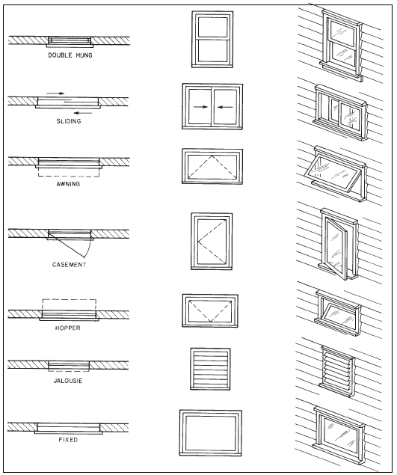
Doors & Windows

